Slide 1
Integration Design Patterns
SE495: Software and Systems Integration

Slide 2
Outline
Hierarchy of enterprise integration patterns
App integration patterns
Horizontal integration of systems’ layers
Integration Security Patterns
Common integration technology classes

Slide 3
Hierarchy of enterprise integration patterns

Slide 4
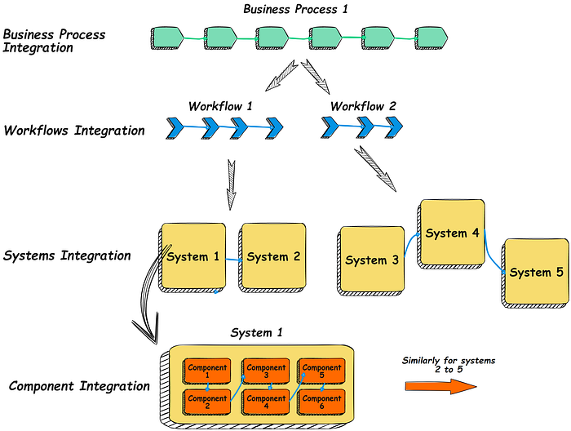
Hierarchy of enterprise integration patterns

Slide 5
Hierarchy of enterprise integration patterns
Business function hierarchy
BPM — Business process management coordinates people, systems, information and things to produce business outcomes for the domains and sub-domains of the enterprise. Examples are product design, manufacturing, marketing, customer acquisition, sales, etc. BPM architecture automates the dynamic integration of business processes to the maximum extent possible to provide well-defined, repeatable, efficient and reliable outcomes.
Workflow — A workflow is a defined sequence of tasks carried out by systems and humans working together to deliver a business task. It can be considered a subset of a business process. An example is the approval workflow of a business loan. Workflow architecture integrates IT systems and humans for the initiation, routing, analytical decision-support, manual steps, automated tasks, coordination, and monitoring of workflows.

Slide 6
Hierarchy of enterprise integration patterns
Business function hierarchy
Systems integration — In a well-designed IT landscape, functionality is divided into cohesive systems mapping to business domain and sub-domain capabilities. These systems must work together to deliver useful outcomes for workflows and business processes. System integration automates their dynamic cooperation. (Read this article for more about the types of systems that need to be integrated → A Practical Abstraction of Functional IT Systems.)
Component integration — All IT systems are internally segregated into cohesive and loosely coupled components and sub-components. These are integrated using standard patterns (see viewpoint #4 below) to deliver the externally useful functions of the system.

Slide 7
Hierarchy of enterprise integration patterns
Technical function hierarchy
Retrying — the server does not respond on the first attempt
Messaging — the server cannot be contacted directly
Load management (queuing, balancing, connection pooling) — the server can respond to a limited number of requests per time unit
Publish-subscribe — the server has information one or more consumers can take while it is fresh

Slide 8
Hierarchy of enterprise integration patterns
Technical function hierarchy
Object transformation — the client and server work with sufficient yet differing data packages
Protocol transformation — the client and server do not use the same communication protocol
Synch-async conversion — the client expects an online response while the server is designed for an offline response or expects an offline response while the server is designed for an online response.
Merging of functions or data — the client has to be served from a combination of more than one operation or information repository

Slide 9
Hierarchy of enterprise integration patterns
Technical function hierarchy
Routing — the correct server has to be reached based on rules
Orchestration — a sequence of operations needs to be performed for the response to the client and the logic is in one place. (Choreography is a related concept, where the action and sequence logic are distributed in the participating services; however it’s functional capability is limited, and it usually turns out there is a centralised orchestrator of some form, even if it is only a passive reference ruleset.)
Version management — different clients need different versions of the same operation
Security (see viewpoint #6 below) — the client and server need to be secured in one or more ways

Slide 10
Hierarchy of enterprise integration patterns
Intermediary integration solution patterns and platforms
RPC — a remote procedure call (RPC) is when a computer program causes a procedure (subroutine) to execute in a different address space (commonly on another computer on a shared network), which is coded as if it were a regular (local) procedure call, to simplify programming and not have to deal with network, protocol, and OS details, etc.
Intra-app integration — interactions between a system's UI, application, domain and repository layers (DDD terms; or UI, business logic and database layers in older terminology), e.g., between the UI and business logic layer (using HTTP(s) protocols) and between the business logic and database layer (using TNS/TTC over TCP/IP protocols for Oracle DB).
Read API (DAL) — a Read API or Data Access Layer is a common integration layer on Operational Data Sources (ODS), Management Information Systems Databases (MIS DBs) and BI business access layers that are accessed by OLTP and OLAP read transactions.
API —an Application Programming Interface is a software interface for communication between IT systems. An API usually supports multiple operations. The design is guided by the standardisation of the function signatures and network protocols, and an API specification document is published. APIs often have various versions available for different clients. Dynamic discovery and binding of APIs and operations by clients during run time may also be supported.

Slide 11
Hierarchy of enterprise integration patterns
Intermediary integration solution patterns and platforms
Messaging Systems — the integration pattern of messaging allows systems to be loosely coupled by communicating asynchronously, making communication more reliable because the two systems do not have to run simultaneously. The messaging system is responsible for transferring data from one system to the other, so they can focus on the information they need to share and not manage the interaction actively. It’s like a letter postal service.
(Message) Queuing Systems — a queuing pattern extends the asynchronous communication pattern of Messaging by providing a pipeline where multiple messages can be stored sequentially by client or server systems until they are consumed, usually on a First In, First Out (FIFO) basis, or become stale. Request messages are put into queues by client systems and picked up and serviced with messages on response queues by serving systems. Queues increase reliability and net throughput and reduce data loss. This loose coupling allows independent and agile development of systems. Managing the queues and their contents, ageing, scaling, logging, etc., are functions provided by the message queueing platform. It’s like queuing up to buy a ticket for a movie.
Publish Subscribe Systems — a publish pattern is an asynchronous and loosely coupled communication pattern for a serving system to make information or functions available that interested clients can subscribe to. It’s like newspaper publishing and subscription by interested readers.

Slide 12
Hierarchy of enterprise integration patterns
Intermediary integration solution patterns and platforms
ESBs — an Enterprise Service Bus combines multiple integration functions, such as messaging, queuing, publish-subscribe, routing, protocol transformation, object transformation, etc., in one software platform. They are one of the most common EAI platforms (see below).
EAI Platforms — broadly, Enterprise Application Integration platforms can provide all the 12 integration functions covered in the Technical Functions Hierarchy section above and solution types 2 to 9 above.
Workflow Managers — Workflow platforms integrate the systems and humans for the initiation, routing, decision-support, manual actions, automated jobs, coordination, and monitoring of the sequence of steps carried out by systems and humans together for a business task.
Business Process Managers — BPM platforms automate the dynamic integration of business processes to provide well-defined, repeatable, efficient and reliable outcomes. They often cover discovery, analysis and optimisation services.

Slide 13
App integration patterns

Slide 14
Application Design Patterns
The ‘Gang of Four’ book on Application Design Patterns covers the following architecturally relevant ones that are briefly described. As an application and integration architect, learn and use these patterns.
Facade — Provides a unified interface to a set of interfaces in a subsystem. Facade defines a higher-level interface that makes the subsystem easier to use, e.g., an API facade for Order collates the interfaces of multiple underlying sub-systems such as ManageStock, CheckPayment, FulfilOrder, etc.
Adapter — Converts the interface of a class into another interface clients expect. The adapter lets classes work together that couldn’t otherwise because of incompatible interfaces. In architectural terms, think system, application, component or sub-component instead of class, e.g., a PaymentGWAdapter fills in a mandatory clienttype field required by a payment system interface with a default value for a client that does not supply it.

Slide 15
Application Design Patterns
Proxy — Provides a surrogate or placeholder for another object to control access to it. Functionally, they can be further divided into Remote Proxy (local representation of a remote API), Virtual Proxy (provide caching and on-demand backend access), Protection Proxy (control access based on roles and rules), and Helper Proxy (provide additional services such as counting, logging, etc.), e.g., a CDN (content delivery network) uses a reverse proxy for security, load balancing, and scaling.
Observer (aka Publish-Subscribe) — Defines a one-to-many dependency between objects so that when one object changes state, all its dependents are notified and updated automatically. (The Event-Driven Architecture pattern is a case of an observer or publish-subscribe application integration pattern.) E.g., if an airline (subject) flight schedule changes and several travel portals (observers) need to know about it, an Observer or Publish-Subscribe pattern integrates them using notifications, requests, etc.

Slide 16
Application Design Patterns
Mediator — Defines an object that encapsulates how a set of objects interact. Mediator promotes loose coupling by keeping objects from explicitly referring to each other and letting you vary their interaction independently, e.g., An eCommerce platform talks to several payment gateways through a mediator so they can all change independently of each other.
Anti-corruption Layer (this pattern comes from DDD) — When systems based on different models are combined, the need for the new system to adapt to the semantics of the other system can lead to a corruption of the new system’s model. Create an isolating layer to provide clients with functionality in terms of their domain model. The layer talks to the other system through its existing interface, requiring little or no modification to the other system. Internally, the layer translates in both directions as necessary between the two models, e.g., A mobile banking application talks to a legacy core banking system through an ACL that separates credit checking from orders that are combined in one function in the legacy system.

Slide 17
Software Engineering Review: Design Patterns
Hardware Patterns
Software Patters
Patterns
Architectural Patterns
Computing Patterns (Computing paradigms)
Design Patterns
A design pattern is a general reusable solution in software design.
A design pattern is not a finished design. It is
A template for solving a problem that can be used in many different situations;
An interface that can have different implementations.
Algorithms of solving a problem is not a part of the design pattern – They belong to the implementation detail / computing pattern.
Not all software patterns are design patterns. Design patterns deal specifically with problems at the level of software design.

Slide 18
Review: Classification of Design Patterns
Creational Patterns: Abstract factory, Factory method, Lazy initialization, Object pool, Singleton, Utility, …
Structural Patterns: Adapter, Decorator, Façade, Proxy, …
Behavioral Patterns: Command, Iterator, Mediator, Observer, State, …
Concurrency Patterns: Active Object, Monitor, Read-Write Lock, Reactor, …

Slide 19
Review: Creational Patterns
Abstract factory: Provide an interface for creating families of objects without specifying their concrete classes.
Factory method: Define an interface for creating an object, but let subclasses decide which class to instantiate. Factory method lets a class defer instantiation to subclasses.
Lazy initialization: Tactic of delaying the creation of an object, the calculation of a value, or some other expensive process until the first time it is needed.
Object pool: Avoid expensive acquisition and release of resources by recycling objects that are no longer in use
Singleton: Ensure a class only has one instance, and provide a global point of access to it.
Utility: A class with a private constructor that contains only static methods.

Slide 20
Review: Structural Patterns
Adapter: Convert the interface of a class into another interface that clients expect.
Decorator: Attach additional responsibilities to an object dynamically. Decorators provide a flexible alternative to sub-classing for extending functionality.
Façade: Provide a unified interface to a set of interfaces in a subsystem. Façade defines a higher-level interface that makes the subsystem easier to use.
Proxy: Provide a surrogate or placeholder for another object to control the access to it.

Slide 21
Review: Behavioral Patterns
Command: Encapsulate a request as an object, thereby letting you parameterize clients with different requests.
Iterator: Provide a way to access the elements of an aggregate object sequentially without exposing its underlying representation.
Mediator between objects: Define an object that encapsulates how a set of objects interact. Mediator promotes loose coupling by keeping objects from referring to each other explicitly, and it lets you vary their interaction independently.
State: Allow an object to alter its behavior when its internal state changes.
Observer: Define a one-to-many dependency between objects so that when one object changes state, all its dependents are notified and updated automatically.

Slide 22
Review: Concurrency Patterns
Active Object: It decouples method execution from method invocation. The goal is to introduce concurrency, by using asynchronous method invocation and a scheduler for handling requests.
Monitor: It is an approach to synchronize two or more tasks that use a shared resource, usually an object.
Read-Write Lock: It allows concurrent read access to an object but requires exclusive access for write operations.
Reactor: It is a concurrent programming pattern for handling service requests delivered concurrently to a service handler by one or more inputs. The service handler then de-multiplexes the incoming requests and dispatches them synchronously to the associated request handlers.

Slide 23
Horizontal integration of systems’ layers

Slide 24
UI layer horizontal integration
Horizontal integrations in the UI layer are increasing, driven by the trend of ‘assembling’ applications by combining ready-to-use services such as product searches, e-commerce portals, payment gateways, etc. Let’s consider this in the three typical types of UIs.
Static Single Page Applications (SPAs) — These are simpler apps where the functionality is all contained in one page, fully served by one or more backend systems. E.g., Gmail, Google Maps, Twitter, Facebook, etc. Horizontal UI integration is less common in SPAs.
Static Multi Page Applications (SMPAs) — Each page in such UIs provides a cohesive set of user functionality, e.g., an eCommerce site. There are different pages for user accounts, orders, support, etc. Each page can be quite independent of the others and connected to a separate backend server component or ‘white label’ partner systems. They are loosely integrated into one web portal or mobile app, but the look and feel is consistent across the pages.
Dynamic Multi Page Applications (DMPAs) — In such applications, there is a core set of pages connected to the primary backend components, but the user tasks also traverse pages populated by systems in other domains of the same enterprise or by partners’ systems, all of which may not be ‘white label’. In such cases, the look and feel of the external pages can be a little or a lot different and change with time. It may also vary between web and mobile versions of the same task.
Most of the UI layer horizontal integration is effected by the (DDD) application layer horizontal integration as below, including such designs as portals with a collection of portlets from different systems.

Slide 25
Application layer horizontal integration
Eric Evans defines the application layer for DDD as ‘Defines the jobs the software is supposed to do and expressive domain objects to work out problems.
The tasks this layer is responsible for are meaningful to the business or necessary for interaction with the application layers of other systems.
This layer is kept thin. It does not contain business rules or knowledge, but only coordinates tasks and delegates work to collaborations of domain objects in the next layer down.
It does not have a state reflecting the business situation, but it can have a state that reflects the progress of a task for the user or the program.’
By its nature, the application layer can integrate with external systems horizontally, as long as there is little or no need to prepare the data for the presentation layer or persist data as per business rules in the backend.
This type of horizontal integration from the application layer (e.g., Javascript running in the browser) is increasing, driven by the trend of ‘assembling’ applications by combining ready-to-use services such as product and service catalogues, eKYC, credit checks, payment APIs, etc. An example standard for this is CORS, Cross-Origin Resource Sharing.

Slide 26
Domain layer horizontal integration
This is still the most common horizontal integration pattern.
Domain layer objects can be specifically created that primarily call out to external systems, prepare the response for the application and UI layers, and update the business state in the persistent store in the infrastructure layer.
Domain-focused business objects may also need to make external calls as a part of their processing.

Slide 27
(Infrastructure) Persistence layer horizontal integration
Horizontal integration of persistent data repositories in the infrastructure layer is required and unavoidable.
The integration architect should consider the following aspects to optimize the integration design and select the appropriate methods, protocols and technologies.
Data can move in raw, modified or enriched form between systems
It can be a subset (usually) or all of the original data
Modifications or transformations can be done at the source, on the way, or in the receiving system
It can move in real-time, near real-time, or with a delay (we may also speak of this as online vs offline; or real-time vs batch)
It can be the unit or aggregated data (the latter by size or time)
Encryption, compression and security requirements

Slide 28
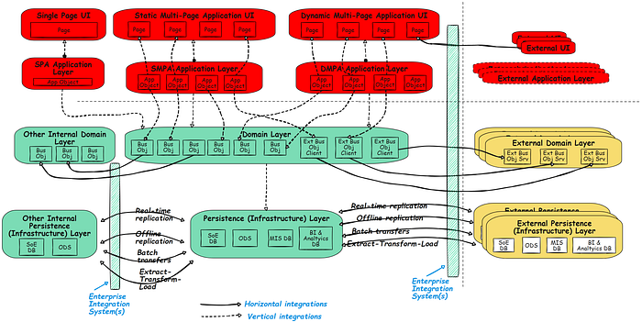
(Infrastructure) Persistence layer horizontal integration

Slide 29
Stateless integration patterns for web & digital applications
In the web and digital services world, being ‘stateless’ is touted as a silver bullet for components not to persist data or care about the past and future and magically get high performance, scaling and agile development.
But no useful business system or task can be stateless. It would be formless or stuck in time and not of much use.
But the idea behind the misnomer of ‘statelessness’ is helpful when we disambiguate it.
It enables architectures to rapidly deliver digital business services by assembling web services.
And it takes advantage of the increasingly egalitarian distribution of processing power between servers and user devices.
A prominent model for stateless architectures is REST — Representational State Transfer.

Slide 30
Function placement Architecture Decision
Problem
how can we build backend and partner services as swarms of identical server units that grow smoothly (from a handful to scores) with the number of clients (thousands to hundreds of millions)?
Architectural Thinking
If the serving systems maintain the real-time state of the user and task, the front end has to stick to the same backend until the task is completed. This wastes resources throughout the ecosystem and limits the number of clients that can be served, as well as rapid scaling up and down with the number of active clients.
What if we move this real-time user and task state knowledge, utilization and management (e.g., logged in, checking out, etc.) responsibility to the UI and Application layers, relieve the domain layer in primary and partner systems from the need to have state, and let them manage only the non-real-time and offline business state (e.g., user role, inventory status, etc.) and persist it in the infrastructure layer.
When we differentiate the user/task state from the business state and their real-time vs non-real-time nature in this manner, all the goodness of statelessness falls into place.
Decision
Make the UI client instance the fixed or ‘sticky’ component in the ecosystem for maintaining the session and state context.
Relieve the server components and supporting ecosystem applications/services from the need to persist or be sticky through knowing or having a real-time state.

Slide 31
Information repository Architecture Decision
There are three types of information involved.
Real-time State information — User and task state that changes rapidly as the use case progresses, e.g., logged in, checking out, payment made, logged out, etc. This is temporary and transient information. Keep it in the client application layer (DDD term) close in memory.
Real-time Context information — Environmental and user information that changes less quickly with the use case, e.g., device type, OS, geolocation, anonymous or identified user, selected airline, etc. Keep this in the client application layer (DDD term) in local semi-permanent stores like cookies, etc.
Non-real-time & Long-term Business State information — Business information that needs to be kept for minutes to years, e.g., users, accounts, profiles, orders, inventory, payments, service history, media, etc. Keep it in server-side caches, RDBMS, files, Hadoop and other appropriate storage repositories.

Slide 32
Information repository Architecture Decision
So we see that the need remains for information and its storage in stateless focused architectures. Clients and caching systems write temporary data in memory or on local disk storage.
And most backend and partner services store long-term data in central databases. These central databases can still be a point of availability and performance issues. Yet, the tradeoff is acceptable for its cost-effectiveness as long-term data is voluminous and cannot be replicated easily like the business logic components of the domain layer.

Slide 33
Integration method Architecture Decision
Problem
(1) How should stateful clients interact with stateless backends and partner systems?
(2) How should stateless backend systems interact with other stateless systems?
Stateful interaction
These interactions happen between the client application layer and backend stateless components.
State-indicating information required by the stateless domain layer backend or partner components is included in the stateful API call by the client.
For example, in the call below asking for an authorisation token, a valid authentication token is necessary and included in the form of the client_id value.

Slide 34
Integration method Architecture Decision
Stateless interaction
In the DDD domain layer, components interact statelessly with components in other domains and external systems.
Based on requests from the client application layer, information is acquired by client components from server components in the form of HyperMedia resources that comprise information and hyperlinks for further action choices.
The information and choices are then returned to the client (DDD application and UI layers) for presentation and next steps.
Here is an example of a request and a stateless RESTful response with information and valid next-state action URI options.
It shows the essence of the ‘representation’ and ‘state-transfer’ information that becomes information and action choices in the UI through the application layer.
This is the REST architecture pattern’s Hypermedia as the Engine of Application State (HATEOAS) design.

Slide 35
Integration method Architecture Decision
Event-Driven Architecture’s integration aspect is essentially a variation of the publish-subscribe integration pattern that supports the asynchronous use of the REST model, which is essential in most large digital solutions.
The key aspects of EDA are: Differentiating events from notifications and topics, pushing rather than polling/pulling changes, cataloguing events, classifying sync/async interactions, refactoring apps to publish/subscribe, Domain-Driven Ubiquitous language for topic semantics, event brokers, event meshes, and preference for choreography over orchestration.

Slide 36
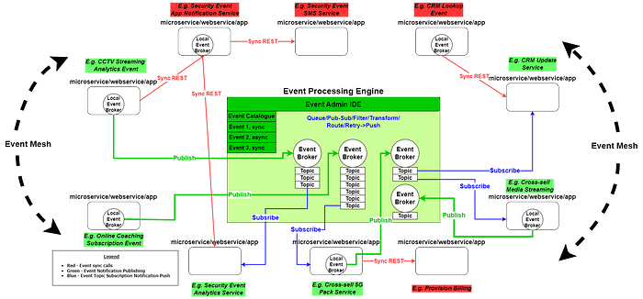
Integration method Architecture Decision
Event-Driven Architecture’s integration

Slide 37
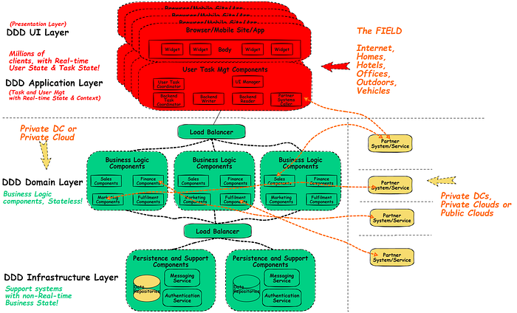
Integration method Architecture Decision
DDD REST System Architecture

Slide 38
Integration Security Patterns

Slide 39
Integration Security Patterns
Broadly there are three areas an enterprise needs to secure:
Business information in stores
User information in stores
Either type of information in flight

Slide 40
Integration Security Patterns
When people or systems communicate, we need to assure them of five things:
They cannot be overheard or spied on (privacy, provided by private networks and encryption)
They are talking to a person or system they know (authentication, provided by 1/2/3 factors)
The person or system has a right to the information or action requested (authorization, provided by roles)
If something goes wrong, it can be investigated (non-repudiation and other details provided by accounting)
Attacks are prevented or withstood while communicating (protection against various types of threats)

Slide 41
Integration Security Patterns
These needs appear in human-to-system and system-to-system interaction channels as below.
Human to machine — keyboard, mouse, stylus, touch, speech, and biometrics.
Machine to machine — The seven OSI network layers, from top to bottom: Application, Presentation, Session, Transport, Network, Data Link, and Physical.

Slide 42
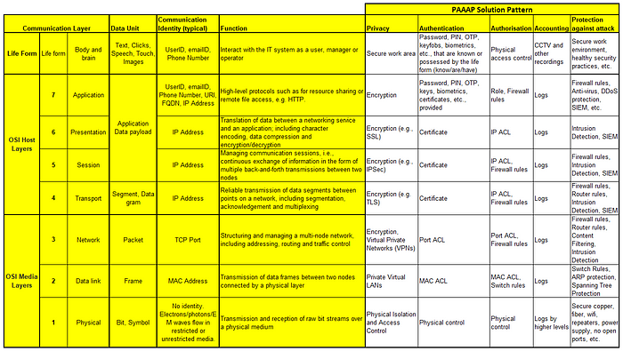

Slide 43
Common integration technology classes

Slide 44
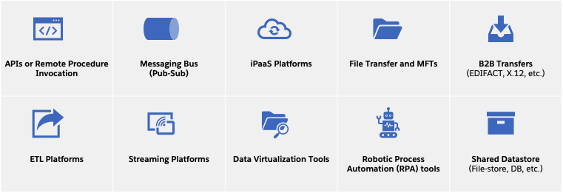
Common integration technology classes

Slide 45
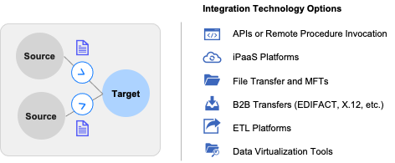
Aggregation of data
Businesses consolidate data from multiple sources for semantic completeness and contextualization purposes.
Building a single view of customer
Migrating data from on-prem applications to a cloud-based data warehouse
Consolidating sensor data and ERP data for advanced analytics on usage patterns
Preparation of executive sales dashboards

Slide 46
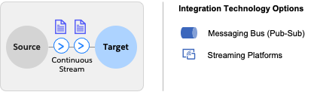
Streaming data ingestion
Most organizations have modern devices and objects that are capable of instrumenting and generating data to reflect the current or past state of the device.
Processing IoT sensor data at edge locations
Real-time consolidation of inventory across stores
Consolidating user click data on retailer websites
Collecting and analyzing machine vibration data to predict failure

Slide 47
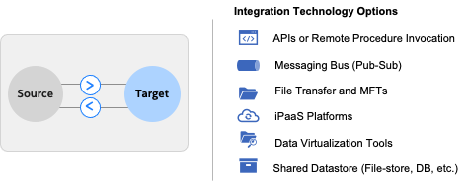
Data sync between multiple applications
For a given piece of data, there is generally a well-defined system of record where its lifecycle is managed.
Upon creation of a new customer account, syncing the account details to ERP, CRM, and Financial applications. Updates to customer accounts can be made in the CRM applications and those updates are sent back to the system of record.
Synchronizing customer data with the customer support applications so your front-line agents can better serve your customers.

Slide 48
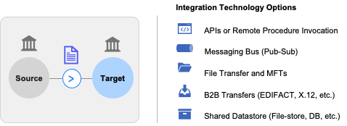
Sharing data with external partners
Any given organization typically works with multiple external business partners, such as suppliers, contractors, government agencies, etc.
Sharing purchase orders with your suppliers
Sharing invoices for payment purposes with your suppliers
Sending tax data with the government
Sharing machine’s operating parameters with the regulatory organization

Slide 49
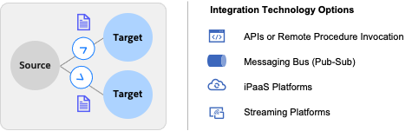
Broadcasting events
Events occur all the time within an organization. New hires, machine shutdowns or failures, expense approvals, payment issues, website traffic exceeding a certain threshold – all of these are classic examples of meaningful events that have downstream impacts and demand further actions.
Tracking a consignment’s shipment status
Sending notifications for customer order fulfillment status
Tracking the inventory updates in real-time
Experiencing a retailer website crash after a surge in user clicks

Slide 50
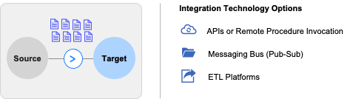
Bulk or batch data movement
There is an ever-growing need to see data as quickly as possible, however, there are valid scenarios where delays in presenting information is acceptable or presenting information in real-time is not required.
One-time migration of customer accounts from an old CRM to Salesforce
Periodic migration of invoices from ERP to payment systems
Nightly reconciliation and analysis of financial transactions from multiple applications
Daily summarization of shipping and receiving transactions

Slide 51
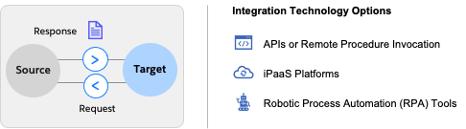
Synchronized data transfers or process triggers
Synchronous data transfers are scenarios where the receiver of the information makes a request for data transfer and waits until the sender has transmitted the requested information.
Retrieving last year’s sales report from the CRM system
Searching for a customer’s invoice within the ERP system
Checking a prepaid balance for your cell phone SIM card
Retrieving a patient’s prescription record before searching for medicine availability

Slide 52
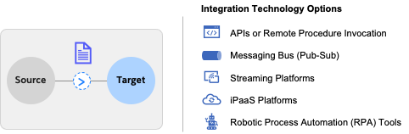
Asynchronous (fire and forget) data transfer or process triggers
Asynchronous data transfer or process triggers are scenarios where the data is sent to a target without an expectation of acknowledgment or confirmation back to the source for success or failure of transfer or process trigger.
Sending promotional texts or emails to prospective customers
Triggering an expense approval workflow
Processing of your insurance claim receipts

Slide 53
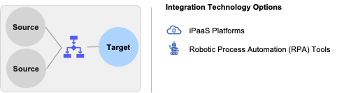
Orchestration and data processing
Significant semantic clarity is built when data from multiple sources are brought together and orchestrated. Orchestration of data provides additional context or clarity.
​​Activating a customer account – credit check, background verification, employment validation, etc.
Processing a new hire employee – salary account setup, IT assets delivery, work locations, etc.

Slide 54
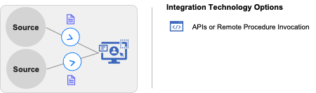
User interface integration and mashups
Integration is often thought of as the transfer of data among applications for machine-level consumption, as described in previous use cases, however, presentation of information in a consolidated format for human consumption is a widely known use case. Information is aggregated in a central location for human consumption.
​​Portals, Intranets
Public Websites
Mobile apps

Slide 55
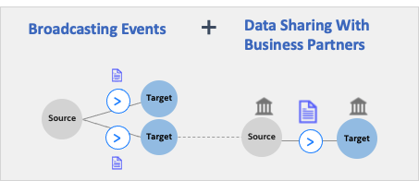
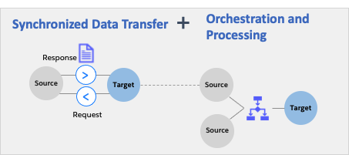
Delivering end-to-end business processes / use cases

